Slide 1





Hiring Process Analytics
Trainity Project By Vaishakh Menon

Slide 2
Description
Approach
Tech-Stack Used
Insights
Data Analytics Tasks
Results
Contents

Slide 3
Hiring Process is the fundamental and the most important function of a company. We must understand the trends such as the number of hired/rejected, interviews, job type and vacancies. In this project we analysis the hiring process data and draw a meaningful insight from it and answer certain questions that can help the company improve its hiring process.
Description

Slide 4
Approach
Handling Missing Data:
Detect and Remove Outliers:
Identifing any missing values in the dataset and develop a strategy to
handle missing data.
Consider statistical methods to detect and remove outliers and understand their potential influence
on the analysis.
Clubbing Columns:
Data Summary:
Evaluate and combine columns with multiple categories that can be consolidated for more streamlined
analysis.
After addressing missing values and outliers, proceed to summarize the dataset. Utilize
statistical measures such as averages, medians, and other relevant metrics to provide a
comprehensive overview of the hiring process. Additionally, create visualizations to enhance the
interpretation of key trends and patterns

Slide 5




Tech-Stack Used
Microsoft Excel
Microsoft PowerPoint
Microsoft Word

Slide 6
Insights
Hiring Analysis:
Salary Distribution:
Determine the gender distribution of hires. How many males and females have been hired by the company.
Create class intervals for the salaries in the company. This will help you understand the salary distribution.
Salary Analysis:
Departmental Analysis:
Calculate the average salary offered by the company using the data.
Useing a bar graph to show the proportion of people working in different departments.
Position Tier Analysis:
Useing a graph to represent the different position tiers within the company. This will help you understand the distribution of positions across different tiers.

Slide 7
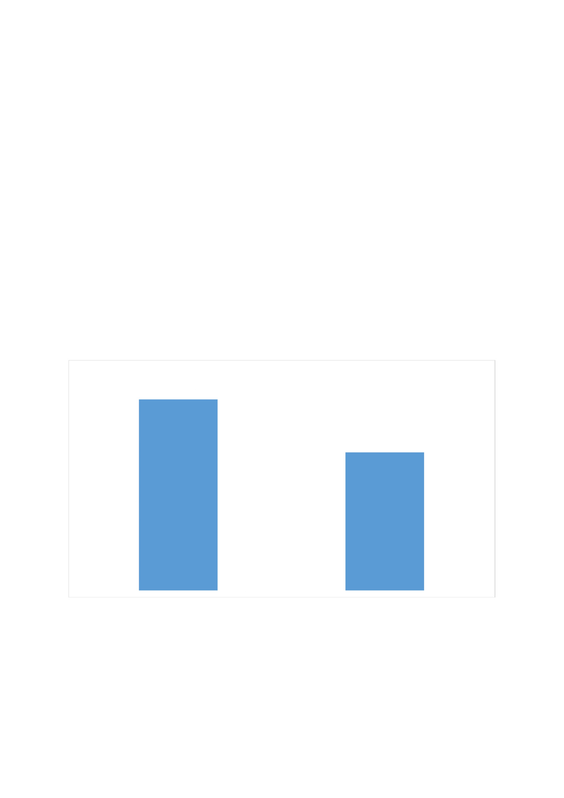
Hiring Analysis:
2562
1854
Male
Female

Slide 8

Salary Analysis:
49878.3318
Average Salary

Slide 9
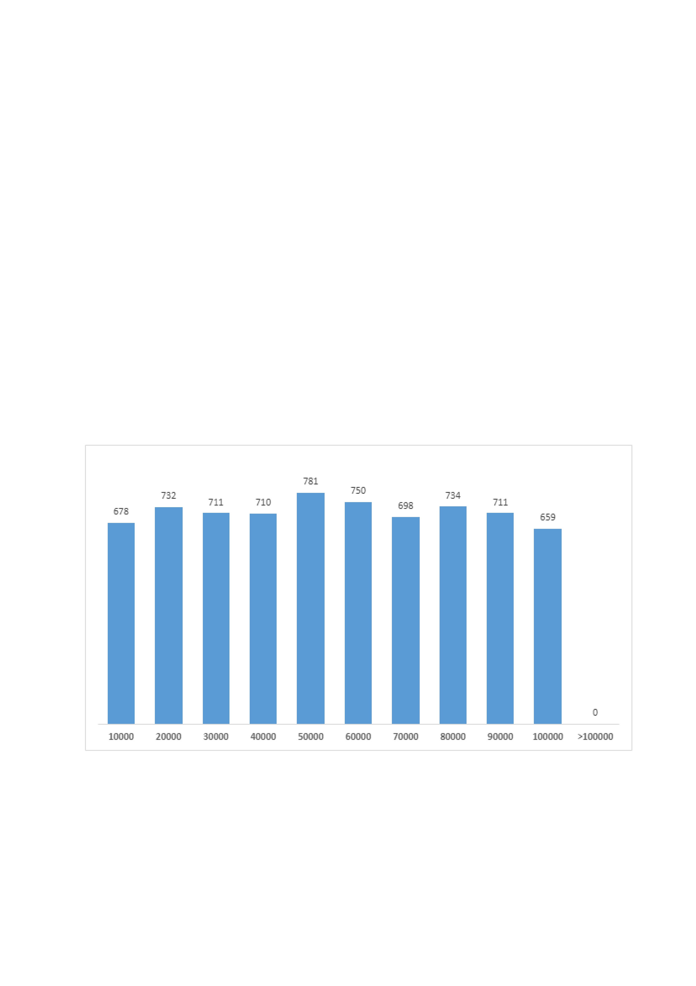
Salary Distribution:

Slide 10
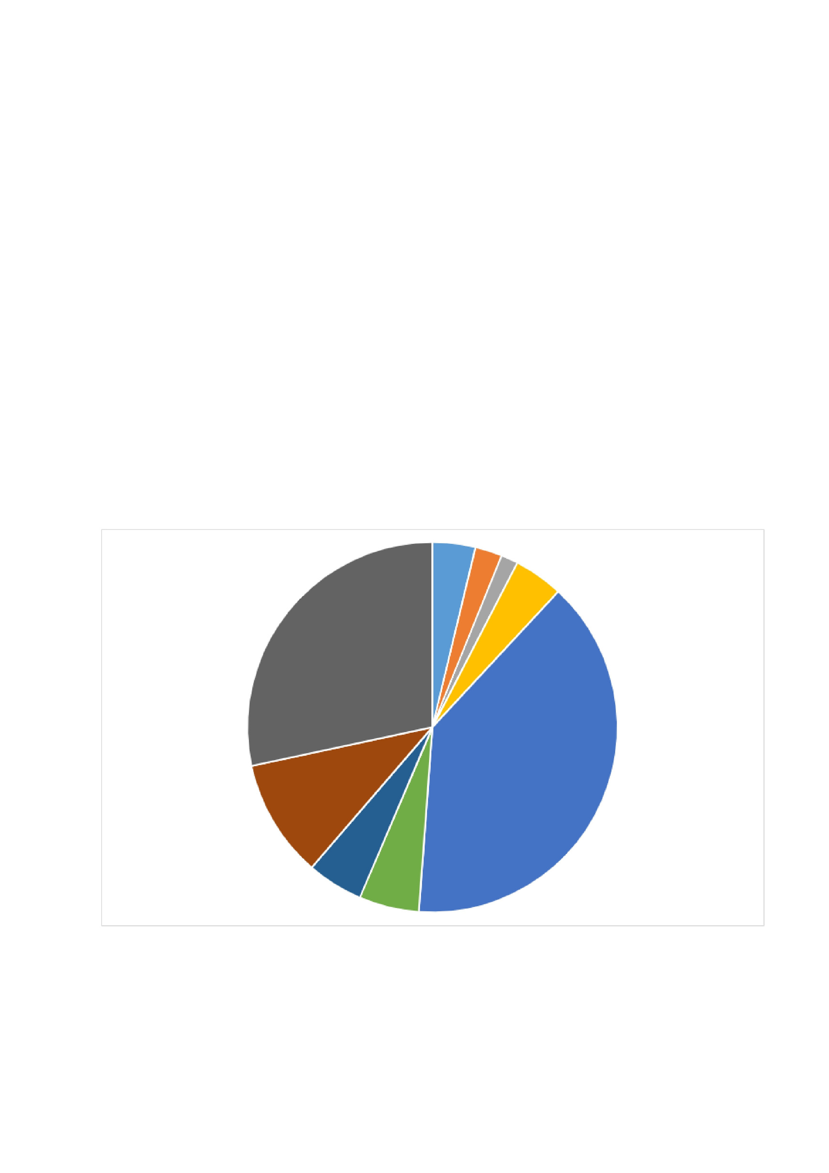
Departmental Analysis:
Finance Department
General Management
Human Resource Department
Marketing Department
Service Department
Sales Department
Purchase Department
Operations Department
Production Department

Slide 11
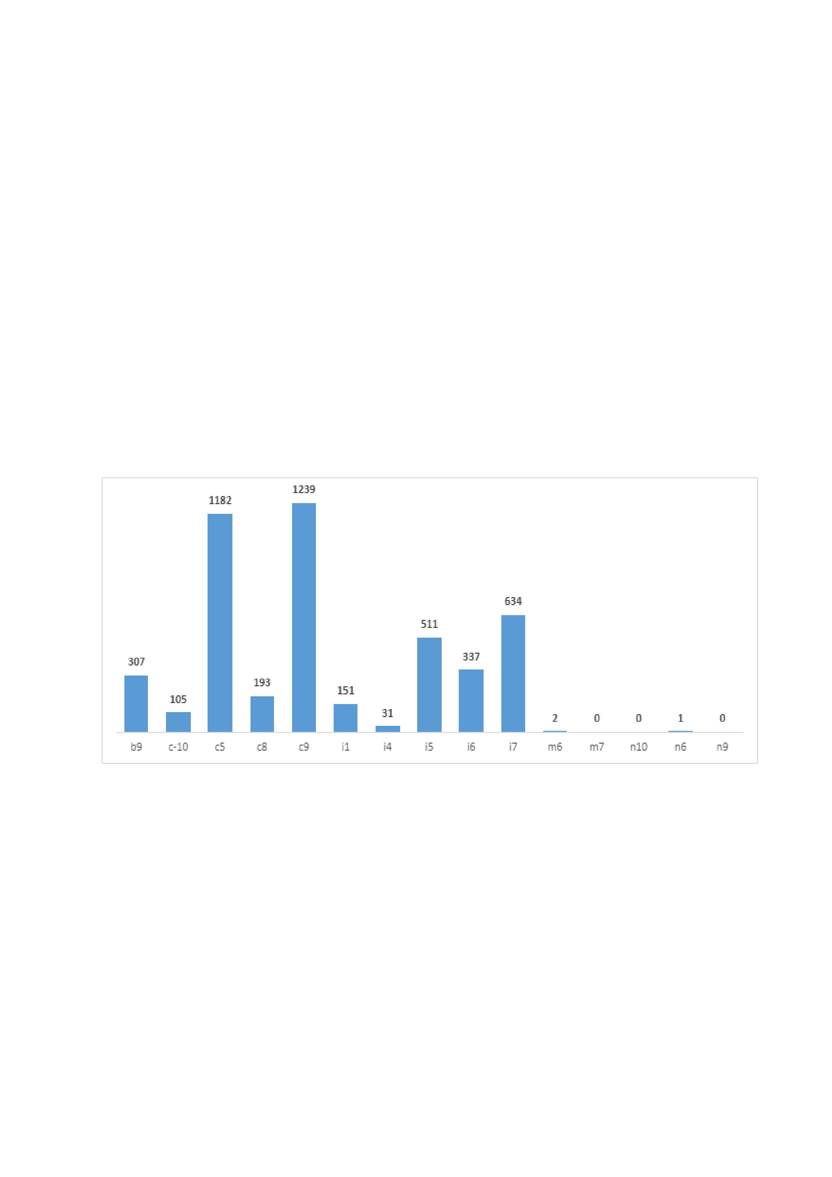
Position Tier Analysis:

Slide 12


Refrence :- Excel Sheet
In the post of c9, there are total 1239 employees are working.
Total 2562 males and 1854 females are hired.
Results
Maximum number of employees(1843) are working in Operations Department.
Employees are getting average 49878.3318 amount of salary.
Total 781 employees are getting salary at the range of 50000.

Slide 13
End
Thank you

